Slide 1


Proto BioCompiler
Jacob Beal
October, 2011
Work partially sponsored by DARPA; the views and conclusions contained in this document are those of the authors and not DARPA or the U.S. Government.

Slide 2

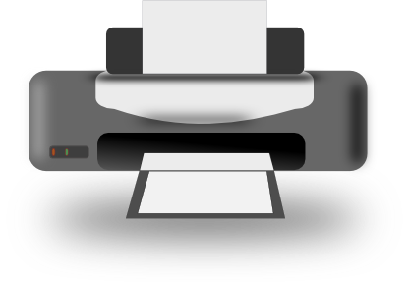

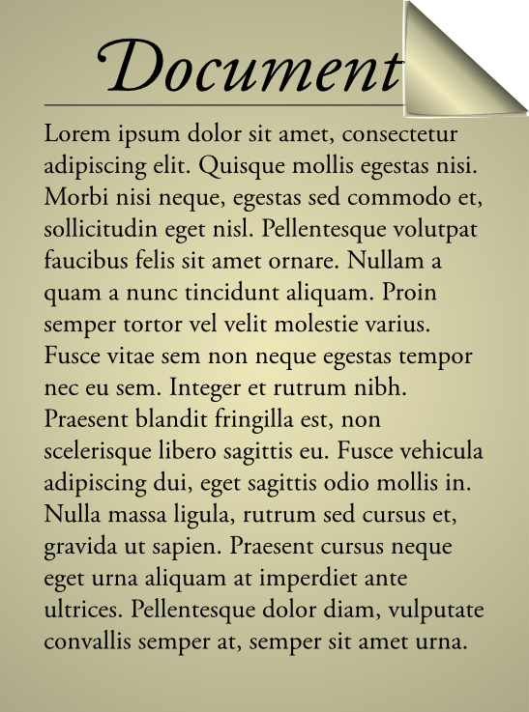
Vision: WYSIWYG Synthetic Biology
Bioengineering should be like document preparation:

Slide 3
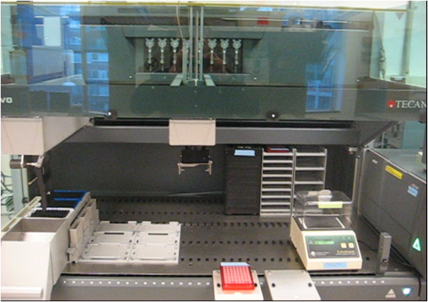
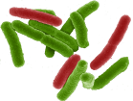
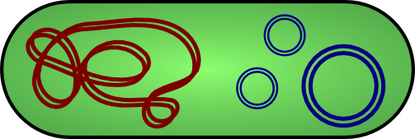
Vision: WYSIWYG Synthetic Biology
Bioengineering should be like document preparation:

Slide 4
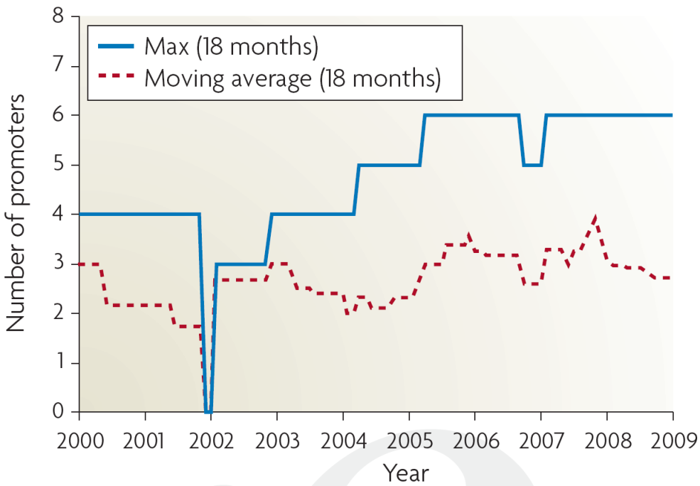
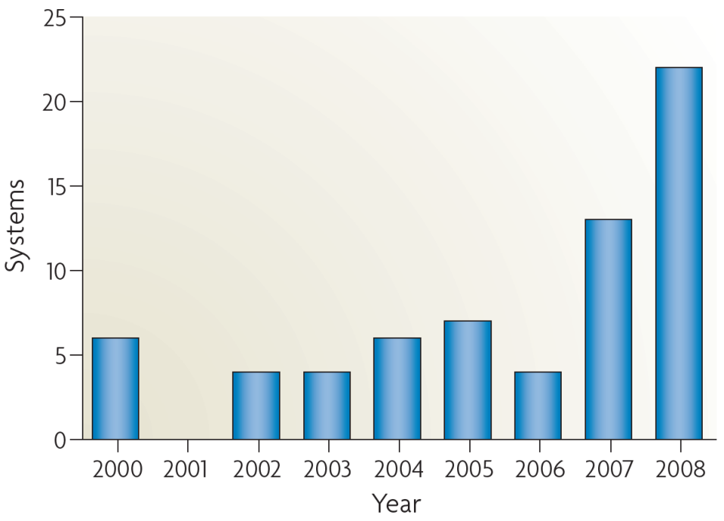
Why is this important?
Breaking the complexity barrier:
Multiplication of research impact
Reduction of barriers to entry
?
DNA synthesis
Circuit size
*Sampling of systems in publications with experimental circuits

Slide 5
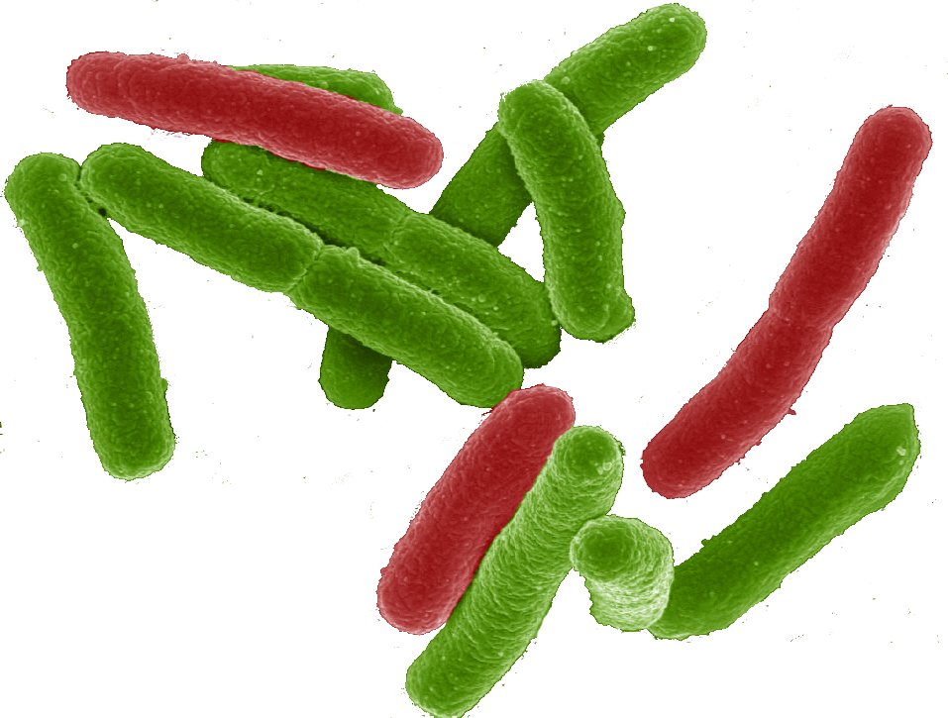
Why a tool-chain?
Organism Level Description
This gap is too big to cross with a single method!
Cells

Slide 6
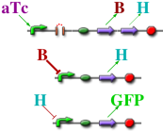
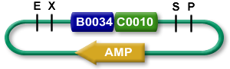
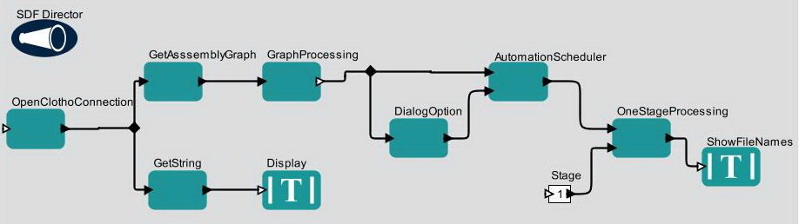
The TASBE architecture:
Organism Level Description
High level simulator
High Level Description
If detect explosives:
emit signal
If signal > threshold:
glow red
Coarse chemical simulator
Abstract Genetic Regulatory Network
Detailed chemical simulator
DNA Parts Sequence
Modular architecture also open for flexible choice of organisms, protocols, methods, …
Assembly Instructions
Testing
Cells

Slide 7
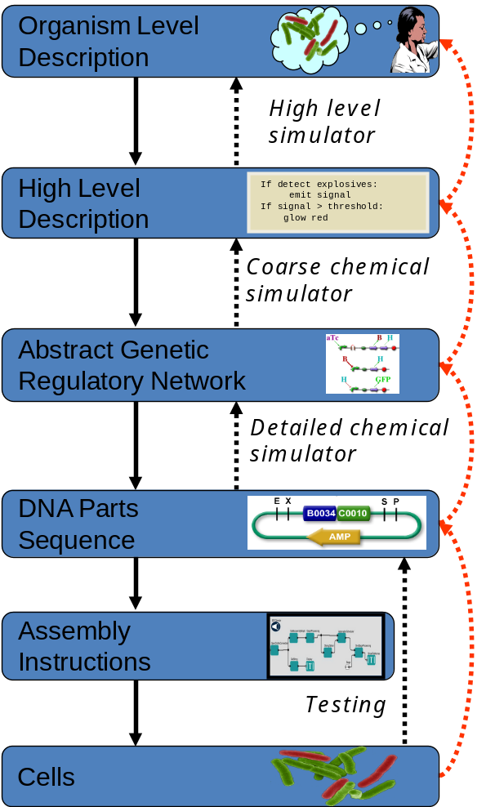
A Tool-Chain Example
  (yellow (not (cyan (Dox))))

Slide 8
A Tool-Chain Example
  (yellow (not (cyan (Dox))))
Dox
cyan
not
yellow

Slide 9
A Tool-Chain Example
  (yellow (not (cyan (Dox))))
Dox
cyan
not
yellow
Dox
rtTA
CFP
B
EYFP

Slide 10
A Tool-Chain Example
  (yellow (not (cyan (Dox))))
Dox
cyan
not
yellow
Dox
rtTA
CFP
B
EYFP
pHef1a
rtTA
pTre
CFP
pTre
LacI
mirff4
pHef1a-LacO1Oid
EYFP
4xff4

Slide 11
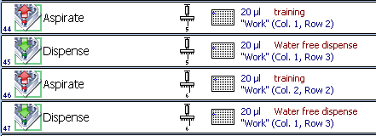
A Tool-Chain Example
  (yellow (not (cyan (Dox))))
Dox
cyan
not
yellow
Dox
rtTA
CFP
B
EYFP
pHef1a
rtTA
pTre
CFP
pTre
LacI
mirff4
pHef1a-LacO1Oid
EYFP
4xff4

Slide 12
A Tool-Chain Example
  (yellow (not (cyan (Dox))))
Dox
cyan
not
yellow
Dox
rtTA
CFP
B
EYFP
pHef1a
rtTA
pTre
CFP
pTre
LacI
mirff4
pHef1a-LacO1Oid
EYFP
4xff4

Slide 13
Today’s focus: BioCompiler
Organism Level Description
High level simulator
High Level Description
Compilation &
Optimization
If detect explosives:
emit signal
If signal > threshold:
glow red
Coarse chemical simulator
Abstract Genetic Regulatory Network
Detailed chemical simulator
DNA Parts Sequence
Assembly Instructions
Testing
Cells

Slide 14
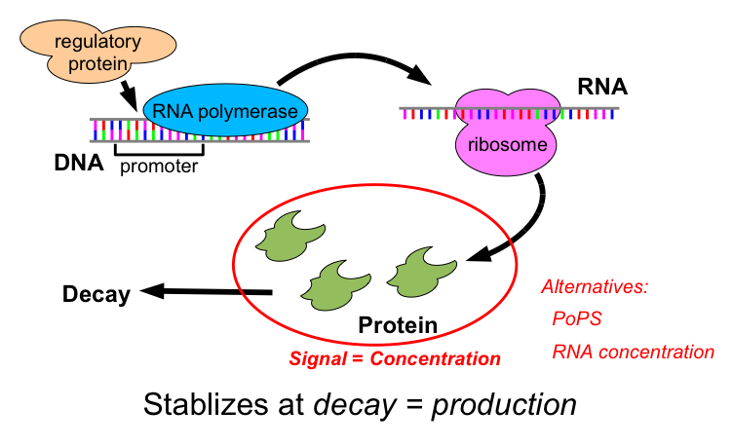
Transcriptional Logic

Slide 15
Motif-Based Compilation
High-level primitives map to GRN design motifs
  e.g. logical operators:
(primitive not (boolean) boolean
:grn-motif ((P high R- arg0 value T)))
arg0
value

Slide 16
Motif-Based Compilation
High-level primitives map to GRN design motifs
  e.g. logical operators, actuators:
(primitive green (boolean) boolean :side-effect
:type-constraints ((= value arg0))
:grn-motif ((P R+ arg0 GFP|arg0 value T)))
arg0
GFP
value

Slide 17
Motif-Based Compilation
High-level primitives map to GRN design motifs
  e.g. logical operators, actuators, sensors:
(primitive IPTG () boolean
:grn-motif ((P high LacI|boolean T)
(RXN (IPTG|boolean) represses LacI)
(P high R- LacI value T)))
IPTG
LacI
value

Slide 18
Motif-Based Compilation
Functional program gives dataflow computation:
(green (not (IPTG)))

Slide 19
Motif-Based Compilation
Functional program gives dataflow computation:
(green (not (IPTG)))
IPTG
not
green

Slide 20
Motif-Based Compilation
Operators translated to motifs:
IPTG
not
green

Slide 21
Motif-Based Compilation
Operators translated to motifs:
IPTG
not
green
IPTG
A
B
LacI
outputs
arg0
outputs
arg0
GFP
outputs

Slide 22
Motif-Based Compilation
Operators translated to motifs:
IPTG
not
green
IPTG
A
B
LacI
outputs
arg0
outputs
arg0
GFP
outputs
IPTG
LacI
A
B
GFP

Slide 23
Optimization
IPTG
LacI
A
B
GFP

Slide 24
Optimization
IPTG
LacI
A
B
GFP
Copy Propagation
IPTG
LacI
A
B
GFP

Slide 25
Optimization
IPTG
LacI
A
B
GFP
Copy Propagation
IPTG
LacI
A
B
GFP
Dead Code Elimination
IPTG
LacI
A
GFP

Slide 26
Optimization
IPTG
LacI
A
B
GFP
Copy Propagation
IPTG
LacI
A
B
GFP
Dead Code Elimination
IPTG
LacI
A
GFP
Dead Code Elimination
IPTG
LacI
A
GFP

Slide 27
Complex System: Feedback Latch
(def sr-latch (s r)
(letfed+ ((o boolean (not (or r o-bar)))
(o-bar boolean (not (or s o))))
o))
(green (sr-latch (aTc) (IPTG)))

Slide 28
Complex System: Feedback Latch
(def sr-latch (s r)
(letfed+ ((o boolean (not (or r o-bar)))
(o-bar boolean (not (or s o))))
o))
(green (sr-latch (aTc) (IPTG)))
IPTG
GFP
LacI
B
I
F
E1
E2
D
I
aTc
C
J
H
G
TetR
A
J
Unoptimized: 15 functional units, 13 transcription factors

Slide 29
Optimization of Complex Designs
(def sr-latch (s r)
(letfed+ ((o boolean (not (or r o-bar)))
(o-bar boolean (not (or s o))))
o))
(green (sr-latch (aTc) (IPTG)))
IPTG
GFP
LacI
B
I
F
E1
E2
D
I
aTc
C
J
H
G
TetR
A
J
Unoptimized: 15 functional units, 13 transcription factors
Copy Propagation

Slide 30
Optimization of Complex Designs
(def sr-latch (s r)
(letfed+ ((o boolean (not (or r o-bar)))
(o-bar boolean (not (or s o))))
o))
(green (sr-latch (aTc) (IPTG)))
IPTG
GFP
E1
B
I
F
LacI
TetR
D
I
aTc
C
J
H
G
A
J
Unoptimized: 15 functional units, 13 transcription factors
Common Subexp. Elim.

Slide 31
Optimization of Complex Designs
(def sr-latch (s r)
(letfed+ ((o boolean (not (or r o-bar)))
(o-bar boolean (not (or s o))))
o))
(green (sr-latch (aTc) (IPTG)))
IPTG
GFP
E1
B
I
F
LacI
TetR
D
I
aTc
C
H
J
G
A
J
H
Unoptimized: 15 functional units, 13 transcription factors
NOR Compression

Slide 32
Optimization of Complex Designs
(def sr-latch (s r)
(letfed+ ((o boolean (not (or r o-bar)))
(o-bar boolean (not (or s o))))
o))
(green (sr-latch (aTc) (IPTG)))
IPTG
E1
GFP
I
F
LacI
TetR
I
aTc
H
G
H
Unoptimized: 15 functional units, 13 transcription factors
Dead Code Elimination

Slide 33
Optimization of Complex Designs
(def sr-latch (s r)
(letfed+ ((o boolean (not (or r o-bar)))
(o-bar boolean (not (or s o))))
o))
(green (sr-latch (aTc) (IPTG)))
IPTG
E1
GFP
I
F
LacI
TetR
I
aTc
H
G
H
Unoptimized: 15 functional units, 13 transcription factors
Copy Propagation

Slide 34
Optimization of Complex Designs
(def sr-latch (s r)
(letfed+ ((o boolean (not (or r o-bar)))
(o-bar boolean (not (or s o))))
o))
(green (sr-latch (aTc) (IPTG)))
IPTG
E1
GFP
H
I
F
LacI
TetR
aTc
G
I
H
Unoptimized: 15 functional units, 13 transcription factors
Common Subexp. Elim.

Slide 35
Optimization of Complex Designs
(def sr-latch (s r)
(letfed+ ((o boolean (not (or r o-bar)))
(o-bar boolean (not (or s o))))
o))
(green (sr-latch (aTc) (IPTG)))
IPTG
GFP
H
I
F
LacI
TetR
aTc
I
H
Unoptimized: 15 functional units, 13 transcription factors
Dead Code Elimination

Slide 36
Optimization of Complex Designs
(def sr-latch (s r)
(letfed+ ((o boolean (not (or r o-bar)))
(o-bar boolean (not (or s o))))
o))
(green (sr-latch (aTc) (IPTG)))
IPTG
I
F
GFP
H
LacI
TetR
aTc
H
I
Unoptimized: 15 functional units, 13 transcription factors

Slide 37
Optimization of Complex Designs
(def sr-latch (s r)
(letfed+ ((o boolean (not (or r o-bar)))
(o-bar boolean (not (or s o))))
o))
(green (sr-latch (aTc) (IPTG)))
IPTG
F
I
GFP
H
LacI
TetR
aTc
H
F
I
Unoptimized: 15 functional units, 13 transcription factors
NOR Compression

Slide 38
Optimization of Complex Designs
(def sr-latch (s r)
(letfed+ ((o boolean (not (or r o-bar)))
(o-bar boolean (not (or s o))))
o))
(green (sr-latch (aTc) (IPTG)))
IPTG
F
GFP
H
LacI
TetR
aTc
H
F
Unoptimized: 15 functional units, 13 transcription factors
Dead Code Elimination

Slide 39
Optimization of Complex Designs
(def sr-latch (s r)
(letfed+ ((o boolean (not (or r o-bar)))
(o-bar boolean (not (or s o))))
o))
(green (sr-latch (aTc) (IPTG)))
IPTG
F
GFP
H
LacI
TetR
aTc
Final Optimized:
5 functional units
4 transcription factors
H
F
Unoptimized: 15 functional units, 13 transcription factors

Slide 40
Compilation & Optimization Results:
Automated GRN design for arbitrary boolean logic and feedback systems
  Verification in ODE simulation
Optimization competitive with human experts:
  Test systems have 25% to 71% complexity reduction
  Optimized systems are often homologous with hand designed networks

Slide 41
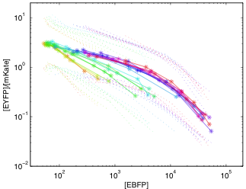
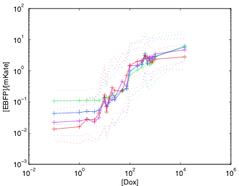
Realization with Characterized DNA parts
Dox
pHef1a
mKate
pHef1a
rtTA
Tre
EBFP
Tre
pLac
Hef1a-LacO1Oid
EYFP

Slide 42
Onward Through the Tool-Chain…
  (yellow (not (cyan (Dox))))
Dox
cyan
not
yellow
Dox
rtTA
CFP
B
EYFP
pHef1a
rtTA
pTre
CFP
pTre
LacI
mirff4
pHef1a-LacO1Oid
EYFP
4xff4

Slide 43
Proto is available
http://proto.bbn.com/
(or google “MIT Proto”)
Includes libraries, compiler, kernel, simulator, platforms
Licensed under GPL (w. libc-type exception)
BioCompiler is available on request

Slide 44



TASBE Project Team:
Jacob Beal (PI)
Aaron Adler
Rick Schantz
Fusun Yaman
Joseph Loyall (PMs)
Ron Weiss (co-PI)
Jonathan Babb
Noah Davidsohn
Douglas Densmore (co-PI)
Swapnil Bhatia
Traci Haddock
Viktor Vasilev
Chenkai Liu
Sponsored by:

