Slide 1
Inductive Modeling
In this presentation, we shall study general techniques for identifying complex non-linear models from observations of input/output behavior.
These techniques make an attempt at mimicking human capabilities of vicarious learning, i.e., of learning from observation.
These techniques should be perfectly general, i.e., the algorithms ought to be capable of capturing an arbitrary functional relationship for the purpose of reproducing it faithfully.
The techniques will also be totally unintelligent, i.e., their capabilities of generalizing patterns from observations are almost non-existent.

Slide 2
Taxonomy of Modeling Methodologies
Knowledge-Based
Approaches
Observation-Based
Approaches
Deep Models
Shallow Models
SD / BG
Inductive Reasoners
Neural Networks
FIR

Slide 3
Observation-based Modeling and Optimization
Any observation-based modeling methodology is closely linked to optimization.
Let us look at the Lotka-Volterra model:
We map the observational knowledge available onto the parameters of the Lotka-Volterra equations, i.e., a, b, c, k, x_{prey0}, and x_{pred0}.
Modeling here means to identify these parameter values, i.e., to minimize the error between the observed and simulated behavior by means of optimization.
·
P_{pred} = -a · P_{pred} + k · b · P_{pred} · P_{prey}
·
P_{prey} = c · P_{prey} − b · P_{pred} · P_{prey}

Slide 4
Observation-based Modeling and Complexity
Observation-based modeling is very important, especially when dealing with unknown or only partially understood systems. Whenever we deal with new topics, we really have no choice, but to model them inductively, i.e., by using available observations.
The less we know about a system, the more general a modeling technique we must embrace, in order to allow for all eventualities. If we know nothing, we must be prepared for anything.
In order to model a totally unknown system, we must thus allow a model structure that can be arbitrarily complex.

Slide 5
Artificial Neural Networks (ANN) I
One very popular approach to model systems from observations is by use of artificial neural networks (ANNs).
ANNs are modeled after the neurons of the human brain.
u₁
w’ is the weight vector
u₂
+
y
b is the bias
…
activation() is a non-linear activation function, usually shaped after the logistic equation, e.g.:
u_{n}
x = w’ · u + b
y = activation(x)
1.0
y = sigmoid(x) =
1.0 + exp(−x)

Slide 6
Artificial Neural Networks (ANN) II
Many such neurons are grouped together in a matrix structure:
The weight matrices and bias vectors between neighboring network layers store the information about the function to be modeled.
+
+
u₁
+
+
+
+
y
u₂
+
+
+
+
+

Slide 7
Artificial Neural Networks (ANN) III
It can be shown that an ANN with a single hidden layer and enough neurons on it can learn any function with a compact domain of the input variables.
With at least two hidden layers, even arbitrary functions with holes in their input domains can be learnt.
u₃
y₃
u₂
Input/output map
y₂
u₁
y₁

Slide 8
Parametric vs. Non-parametric Models I
ANNs are parametric models. The observed knowledge about the system under study is mapped on the (potentially very large) set of parameters of the ANN.
Once the ANN has been trained, the original knowledge is no longer used. Instead, the learnt behavior of the ANN is used to make predictions.
This can be dangerous. If the testing data, i.e. the input patterns during the use of the already trained ANN differ significantly from the training data set, the ANN is likely to predict garbage, but since the original knowledge is no longer in use, we are unlikely to be aware of the problem.

Slide 9
Parametric vs. Non-parametric Models II
Non-parametric models, on the other hand, always refer back to the original training data, and therefore, can be made to reject testing data that are incompatible with the training data set.
The Fuzzy Inductive Reasoning (FIR) engine that we discuss in this presentation, is of the non-parametric type.
During the training phase, FIR organizes the observed patterns, and places them in a data base.
During the testing phase, FIR searches the data base for the five most similar training data patterns, the so-called five nearest neighbors, by comparing the new input pattern with those stored in the data base. FIR then predicts the new output as a weighted average of the outputs of the five nearest neighbors.

Slide 10
Quantitative vs. Qualitative Models I
Training a model (be it parametric or non-parametric) means solving an optimization problem.
In the parametric case, we have to solve a parameter identification problem.
In the non-parametric case, we need to classify the training data, and store them in an optimal fashion in the data base.
Training such a model can be excruciatingly slow.
Hence it may make sense to devise techniques that will help to speed up the training process.

Slide 11
Quantitative vs. Qualitative Models II
How can the speed of the optimization be controlled? Somehow, the search space needs to be reduced.
One way to accomplish this is to convert continuous variables to equivalent discrete variables prior to optimization.
For example, if one of the variables to be looked at is the ambient temperature, we may consider to classify temperature values on a spectrum from very cold to extremely hot as one of the following discrete set:
temperature = { freezing, cold, cool, moderate, warm, hot }

Slide 12
Qualitative Variables
A variable that only assumes one among a set of discrete values is called a discrete variable. Sometimes, it is also called a qualitative variable.
Evidently, it must be cheaper to search through a discrete search space than through a continuous search space.
The problem with discretization schemes, such as the one proposed above, is that a lot of potentially valuable detailed information is being lost in the process.
To avoid this pitfall, L. Zadeh proposed a different approach, called fuzzification.

Slide 13
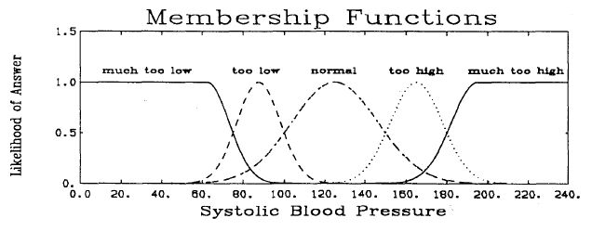
Fuzzy Variables I
Fuzzification proceeds as follows. A continuous variable is fuzzified by decomposing it into a discrete class value and a fuzzy membership value.
For the purpose of reasoning, only the class value is being considered. However, for the purpose of interpolation, the fuzzy membership value is also taken into account.
Fuzzy variables are not discrete, but they are also referred to as qualitative.

Slide 14
Fuzzy Variables II
Systolic blood pressure = 110
Systolic blood pressure = 141
⇒ { normal, 0.78 } ∩ { too low, 0.15 }
⇒ { normal, 0.78 } ∩ { too high, 0.18 }
{ Class, membership } pairs of lower likelihood must be considered as well, because otherwise, the mapping would not be unique.

Slide 15
Fuzzy Variables in FIR
FIR embraces a slightly different approach to solving the uniqueness problem. Rather than mapping into multiple fuzzy rules, FIR only maps into a single rule, that with the largest likelihood. However, to avoid the aforementioned ambiguity problem, FIR stores one more piece of information, the “side value.” It indicates, whether the data point is to the left or the right of the peak of the fuzzy membership value of the given class.
left
right
Systolic blood pressure = 110
Systolic blood pressure = 141
⇒ { normal, 0.78, left }
⇒ { normal, 0.78, right }

Slide 16
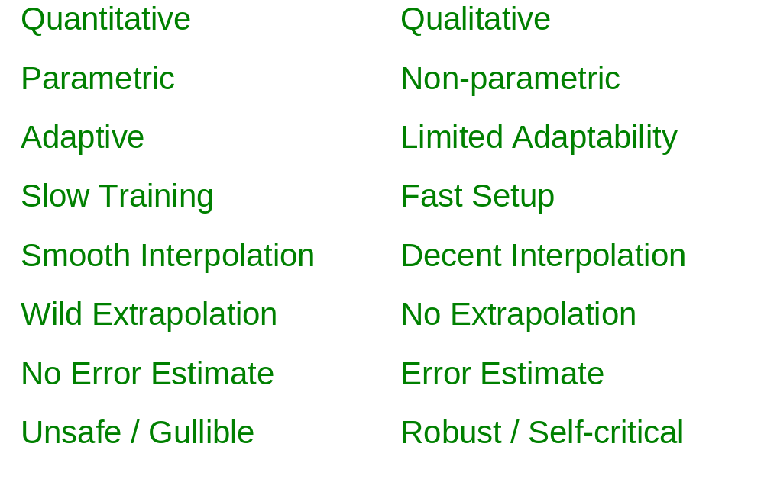
Neural Networks vs. Inductive Reasoners
Neural Networks
Fuzzy Inductive R.

Slide 17
Fuzzy Inductive Reasoning (FIR) I
Discretization of quantitative information (Fuzzy Recoding)
Reasoning about discrete categories (Qualitative Modeling)
Inferring consequences about categories (Qualitative Simulation)
Interpolation between neighboring categories using fuzzy logic (Fuzzy Regeneration)

Slide 18
Fuzzy Inductive Reasoning (FIR) II
FIR
Crisp data
Crisp data
Fuzzy
Recoding
Regene-
ration
Fuzzy
Modeling
Fuzzy
Simulation

Slide 19
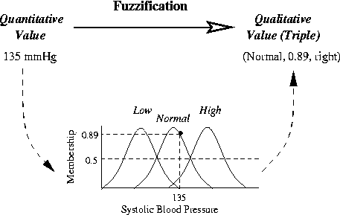
Fuzzification in FIR

Slide 20
Qualitative Modeling in FIR I
Once the data have been recoded, we wish to determine, which among the possible set of input variables best represents the observed behavior.
Of all possible input combinations, we pick the one that gives us as deterministic an input/output relationship as possible, i.e., when the same input pattern is observed multiple times among the training data, we wish to obtain output patterns that are as consistent as possible.
Each input pattern should be observed at least five times.

Slide 21
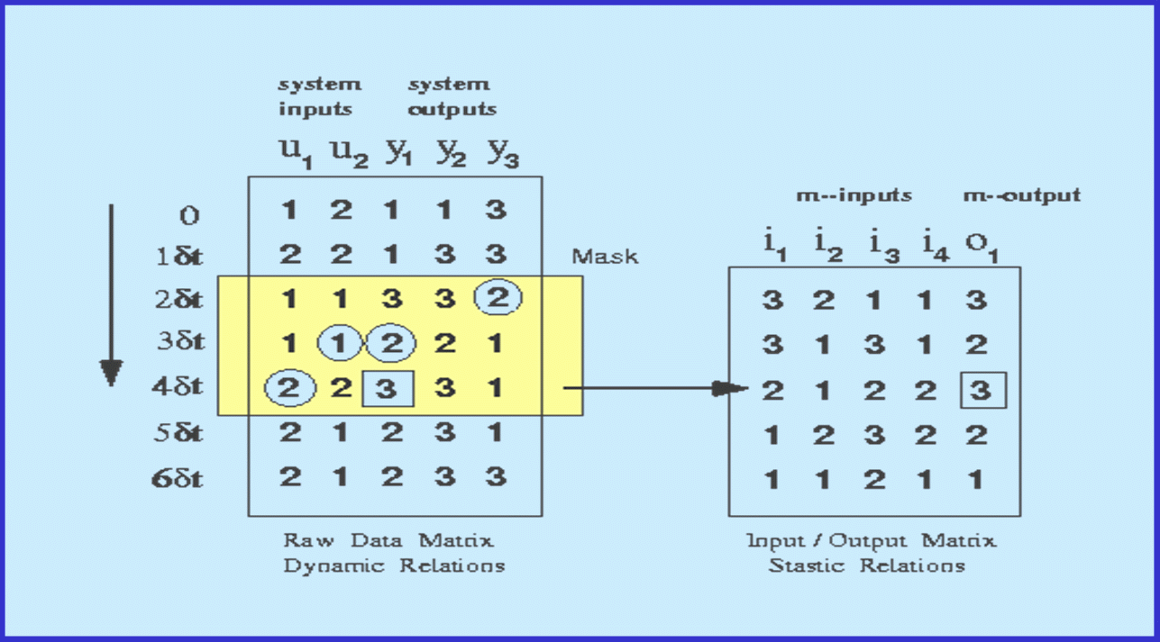
Qualitative Modeling in FIR II
system inputs
system outputs
Fuzzy rule base
model output
model inputs
mask
raw data matrix (dynamic relations)
input/output matrix (static relations)
y₁(t) = f ( y₃(t−2δt), u₂(t−δt) , y₁(t−δt) , u₁(t) )

Slide 22
Qualitative Modeling in FIR III
The qualitative model is the optimal mask, i.e., the set of inputs that best predict a given output.
Usually, the optimal mask is dynamic, i.e., the current output depends both on current and past values of inputs and outputs.
The optimal mask can then be applied to the training data to obtain a set of fuzzy rules that can be alphanumerically sorted.
The fuzzy rule base is our training data base.

Slide 23
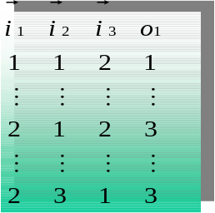




Qualitative Simulation in FIR
Behavior Matrix
Raw Data Matrix
2
Optimal
Mask
2
Input Pattern
3
Matched Input Patterns
1
3
Euclidean
Distance
Computation
d_{j}
1
1
?
5-Nearest Neighbors
Class
Forecast Value
Output Computation
f_{i}=F(W*5-NN-out)
Membership
Side

Slide 24
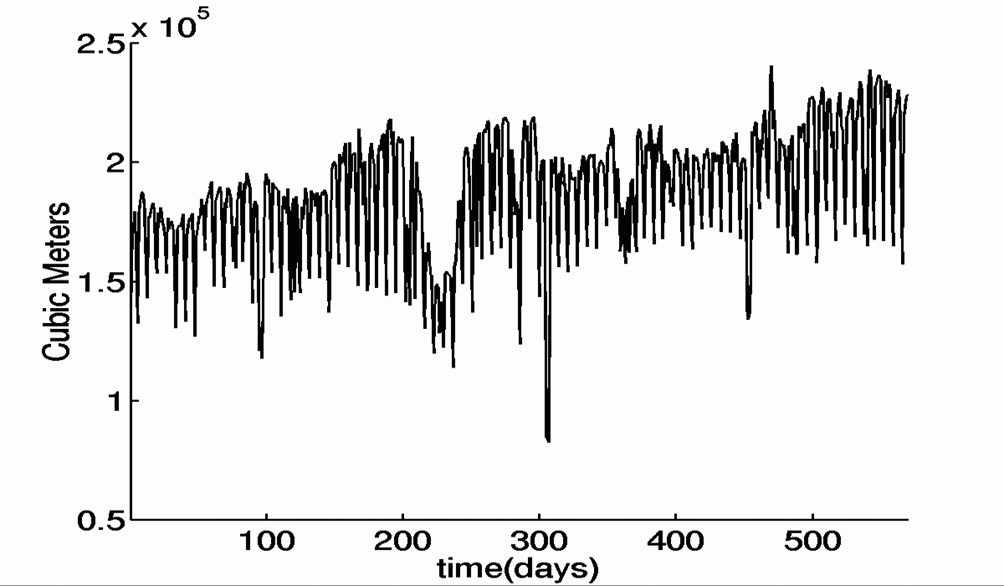
Time-series Prediction in FIR
Water demand for the city of Barcelona, January 85 – July 86

Slide 25
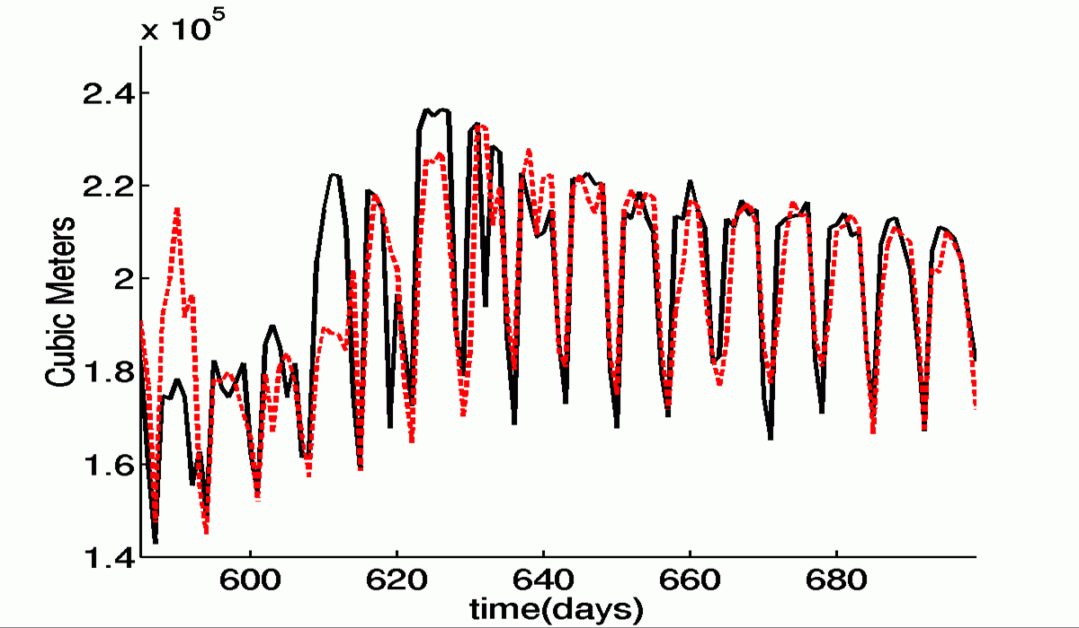
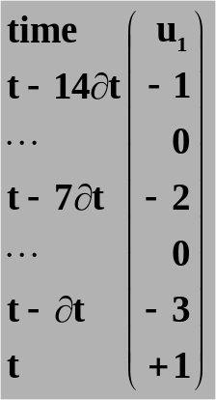
Simulation Results I
Prediction
Real

Slide 26
Quantitative vs. Qualitative Modeling
Deductive Modeling Techniques
* have a large degree of validity in many different and even previously unknown applications
* are often quite imprecise in their predictions due to inherent model inaccuracies
Inductive Modeling Techniques
* have a limited degree of validity and can only be applied to predicting behavior of systems that are essentially known
* are often amazingly precise in their predictions if applied carefully

Slide 27
Mixed Quantitative & Qualitative Modeling
It is possible to combine qualitative and quantitative modeling techniques.
FIR Model
Regenerate
Quantitative Subsystem
FIR Model
Recode
Recode
Regenerate
Quantitative Subsystem

Slide 28
Application: Cardiovascular System I
Let us apply the technique to a fairly complex system: the cardiovascular system of the human body.
The cardiovascular system is comprised of two subsystems: the hemodynamic system and the central nervous control.
The hemodynamic system describes the flow of blood through the heart and the blood vessels.
The central nervous control synchronizes the control algorithms that control the functioning of both the heart and the blood vessels.

Slide 29
Application: Cardiovascular System II
The hemodynamic system is essentially a hydrodynamic system. The heart and blood vessels can be described by pumps and valves and pipes. Thus bond graphs are suitable for its description.
The central nervous control is still not totally understood. Qualitative modeling on the basis of observations may be the tool of choice.

Slide 30
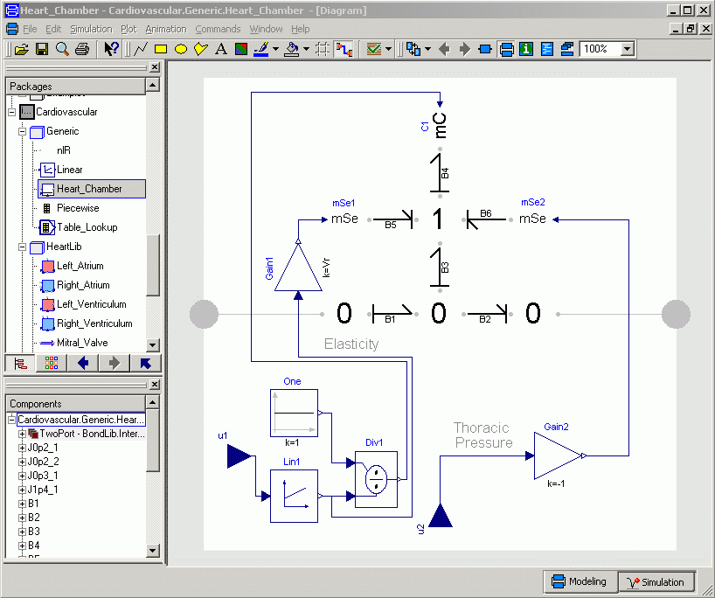
The Hemodynamic System I
The heart chambers and blood vessels are containers of blood. Each container is a storage of mass, thus contains a C-element.
The C-elements are partly non-linear, and in the case of the heart chambers even time-dependent.
The mSe-element on the left side represents the residual volume of the vessel.
The mSe-element on the right side represents the thoracic pressure, which is influenced by the breathing.

Slide 31
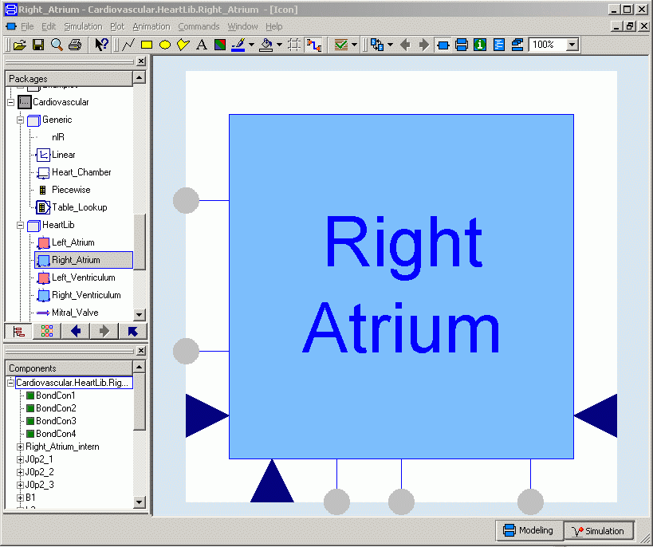
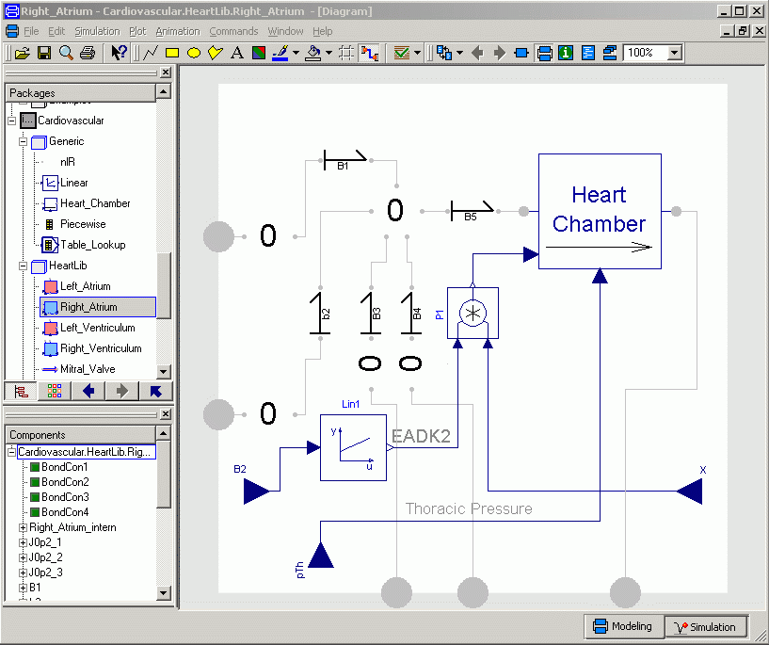
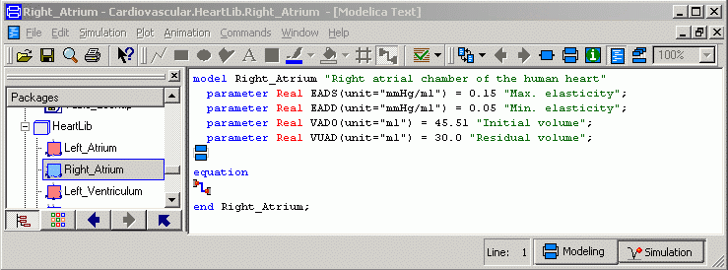
The Hemodynamic System II

Slide 32
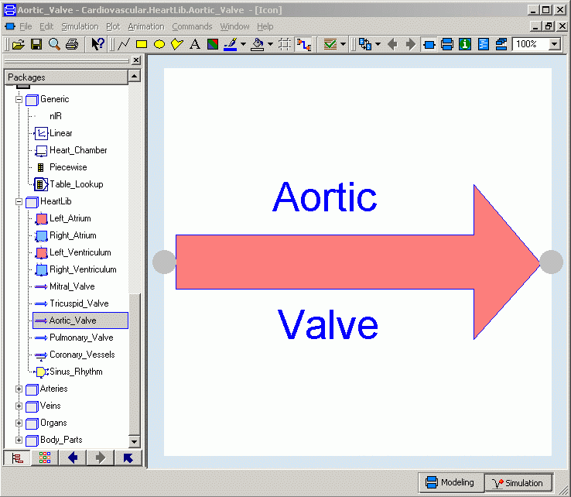
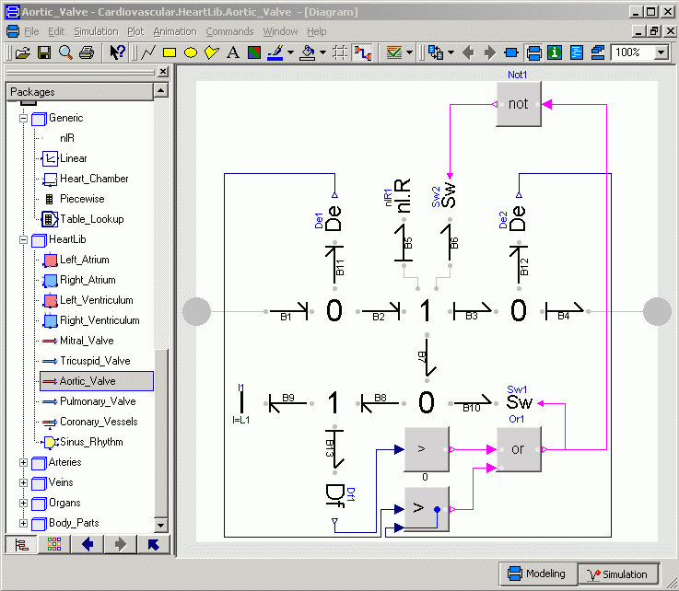
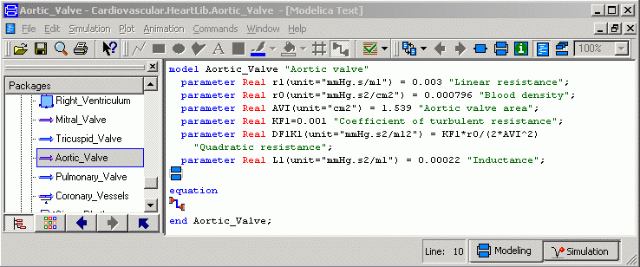
The Hemodynamic System III

Slide 33
The Hemodynamic System IV
All containers are drawn as boxes. They end in 0-junctions.
All flows between containers are drawn as arrows. They end in bonds.
As long as containers and flows toggle, they can be connected together without bonds in between.
Some of the flows contain inductors, others only resistances. Some of them also contain valves, which are represented by Sw-elements.

Slide 34
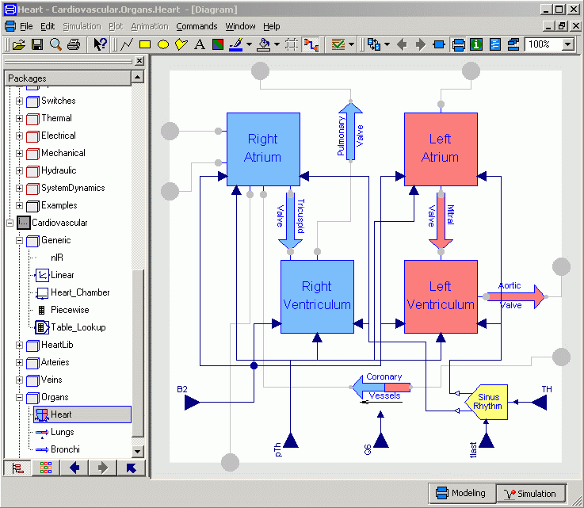
The Heart
The heart contains the four chambers, as well as the four major heart valves, the pulmonary and aorta valves at the exits of the ventricula, and the mitral and triscuspid valves between the atria and the corresponding ventricula.
The sinus rhythm block programs the contraction and relaxation of the heart muscle.
The heart muscle flow symbolizes the coronary blood vessels that are responsible for supplying the heart muscle with oxygen.

Slide 35
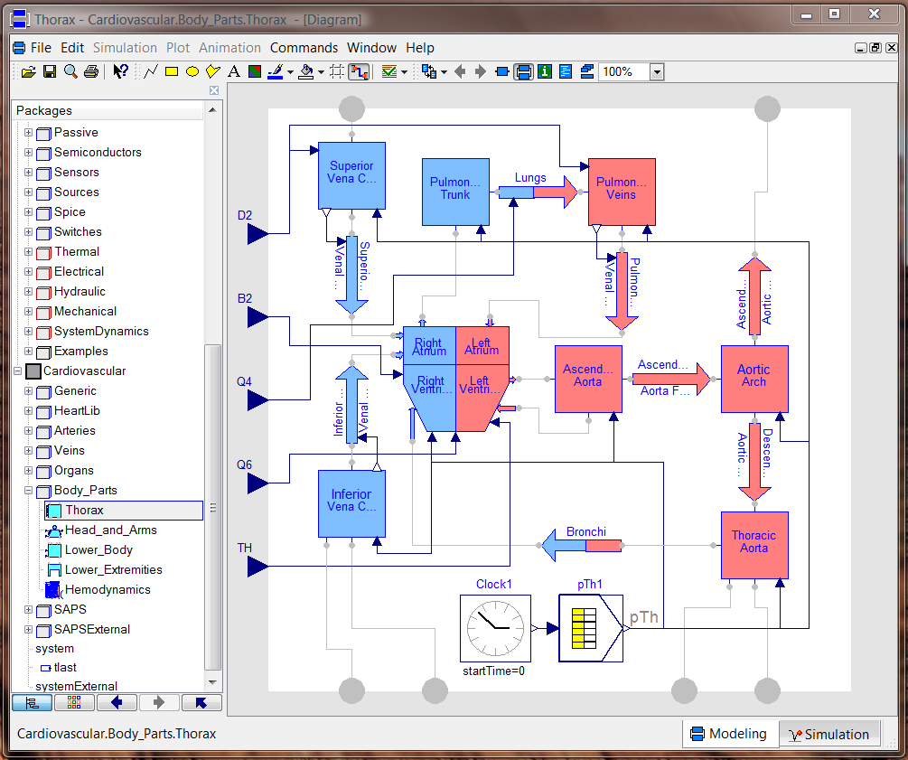
The Thorax
The thorax contains the heart and the major blood vessels.
The table lookup function at the bottom computes the thoracic pressure as a function of the breathing.
The arterial blood is drawn in red, whereas the venous blood is drawn in blue.
Shown on the left are the central nervous control signals.

Slide 36
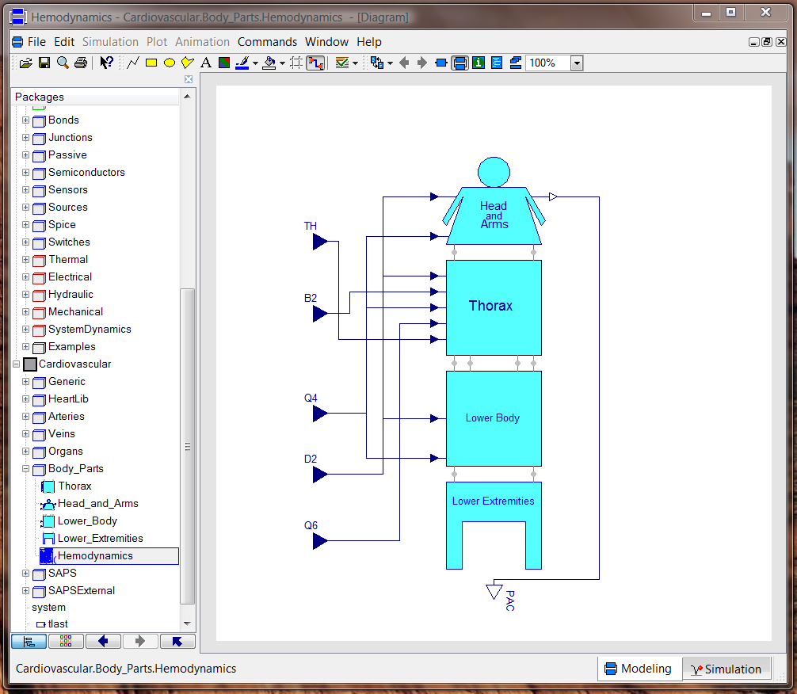
The Body Parts
In similar ways, also the other parts of the circulatory system can be drawn. These include the head and arms (the brachiocephalic trunk and veins), the abdomen (the gastrointestinal arteries and veins), and the lower limbs.
Together they form the hemodynamic system.

Slide 37
Central Nervous System Control
What is lacking still are the central nervous control functions, i.e., the external drivers that determine:
These external drivers are computed by five parallel qualitative (FIR) models.
when and how often the heart beats,
how much the heart chambers contract,
the rigidity/flexibility of the veins…
January 18, 2014
Notes:
37

Slide 38
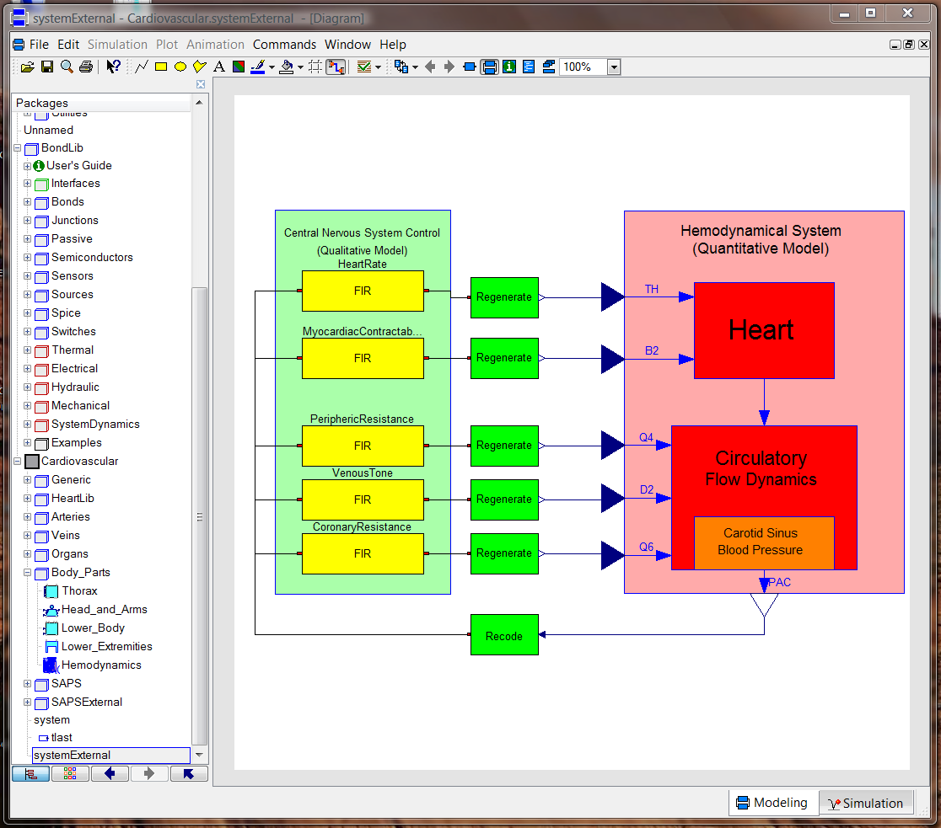
The Cardiovascular System
Pressure of the arteries in the brain.

Slide 39
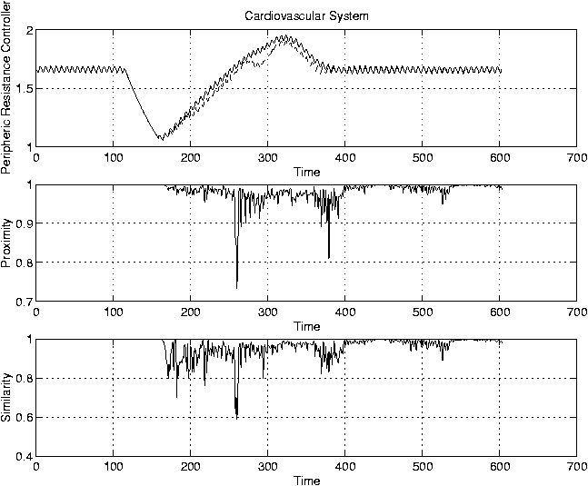
Simulation Results II

Slide 40
Discussion I
The top graph shows the peripheric resistance controller, Q4, during a Valsalva maneuver.
The true data are superposed with the simulated data. The simulation results are generally very good. However, in the center part of the graph, the errors are a little larger.
Below are two graphs showing the estimate of the probability of correctness of the prediction made. It can be seen that FIR is aware that the simulation results in the center area are less likely to be of high quality.

Slide 41
Discussion II
This can be exploited. Multiple predictions can be made in parallel together with estimates of the likelihood of correctness of these predictions.
The predictions can then be kept that are accompanied by the highest confidence value.
This is shown on the next graph. Two different models (sub-optimal masks) are compared against each other. The second mask performs better, and also the confidence values associated with these predictions are higher.

Slide 42
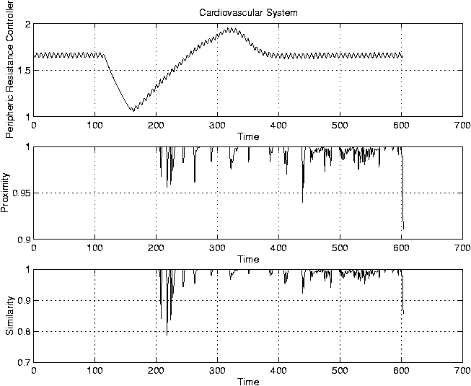
Simulation Results III

Slide 43
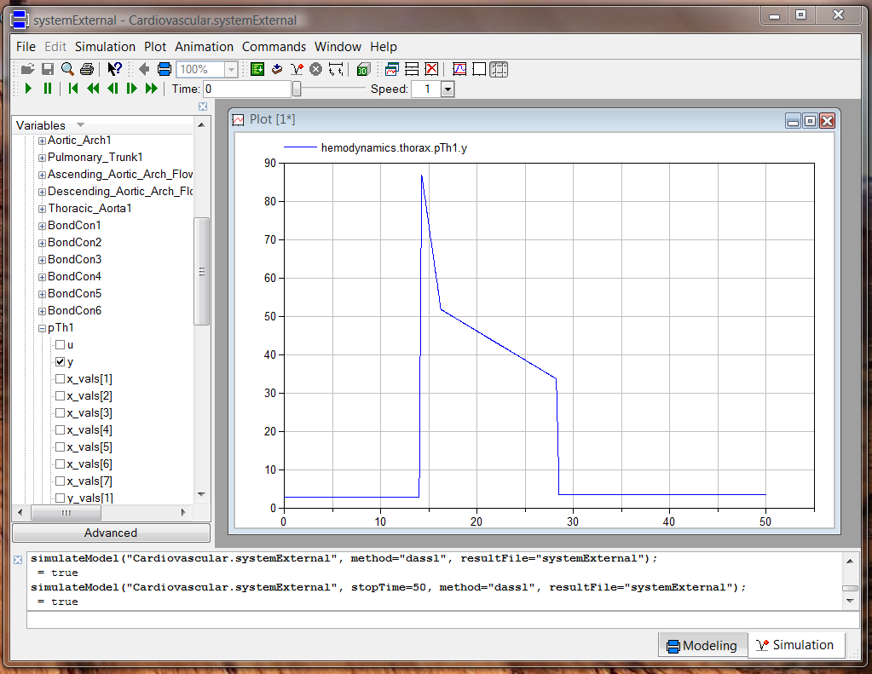
Simulation Results IV
January 18, 2014
Notes:
43

Slide 44
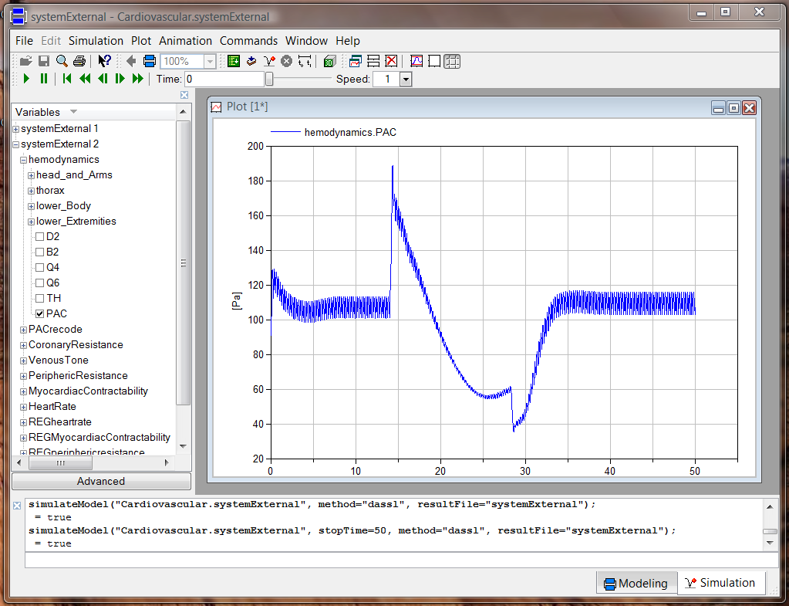
Simulation Results V
January 18, 2014
Notes:
44

Slide 45
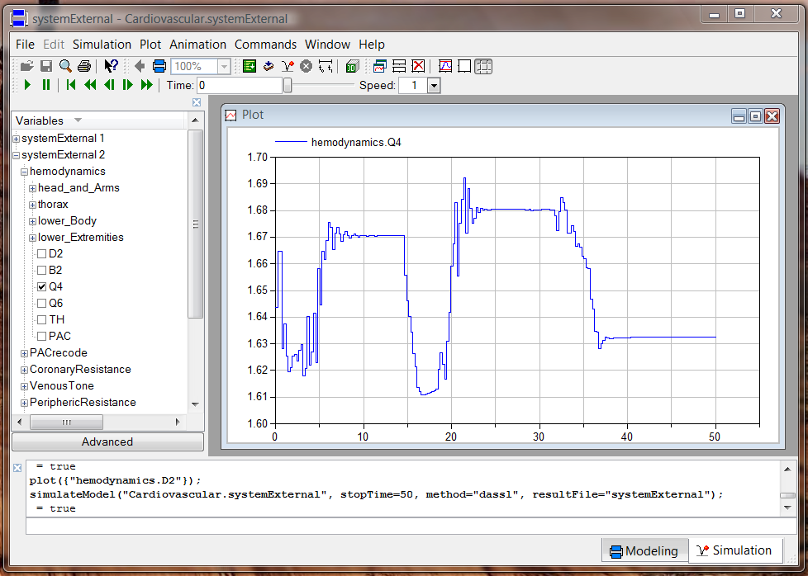
Simulation Results VI
January 18, 2014
Notes:
45

Slide 46
Conclusions I
Quantitative modeling, i.e. modeling from first principles, is the appropriate tool for applications that are well understood, and where the meta-laws are well established.
Physical modeling is most desirable, because it offers most insight and is most widely extensible beyond the range of previously made experiments.
Qualitative modeling is suitable in areas that are poorly understood, where essentially all the available knowledge is in the observations made and is still in its raw form, i.e., no meta-laws have been extracted yet from previous observations.

Slide 47
Conclusions II
Fuzzy modeling is a highly attractive inductive modeling approach, because it enables the modeler to obtain a measure of confidence in the predictions made.
Fuzzy inductive reasoning is one among several approaches to fuzzy modeling. It has been applied widely and successfully to a fairly wide range of applications both in engineering and in the soft sciences.
Qualitative models cannot provide insight into the functioning of a system. They can only be used to predict their future behavior, as long as the behavioral patterns stay within their observed norms.

Slide 48
Industrial Applications
Cardiovascular System Modeling for Classification of Anomalies.
Anesthesiology Model for Control of Depth of Anesthesia During Surgery.
Shrimp Growth Model for El Remolino Shrimp Farm in Northern Mexico.
Prediction of Water Demand in Barcelona, Rotterdam, and Lisbon.
Design of Fuzzy Controller for Tanker Ship Steering.
Fault Diagnosis of Nuclear Power Plants.
Prediction of Technology Changes in the Telecommunication Industry.

Slide 49
References I
Cellier, F.E. (1991), Continuous System Modeling, Springer-Verlag, New York, Chapter 13.
Cellier, F.E. (1991), Continuous System Modeling, Springer-Verlag, New York, Chapter 14.
Cellier, F.E., A. Nebot, F. Mugica, and A. de Albornoz (1996), “Combined Qualitative/Quantitative Simulation Models of Continuous-Time Processes Using Fuzzy Inductive Reasoning Techniques,” Intl. J. General Systems, 24(1-2), pp.95-116.

Slide 50
References II
Nebot, À., F.E. Cellier, and M. Vallverdú (1998), “Mixed Quantitative/Qualitative Modeling and Simulation of the Cardiovascular System,” Computer Methods and Programs in Biomedicine, 55(2), pp.127-155.
Cellier, F.E. and À. Nebot (2005), “Object-oriented Modeling in the Service of Medicine,” Proc. 6th Asia Simulation Conference, Beijing, China, Vol.1, pp.33-40.
Cellier, F.E. and V. Sanz (2009), “Mixed Quantitative and Qualitative Simulation in Modelica,” Proc. 7th Intl. Modelica Conference, Como Italy, pp.86-95.

Slide 51
Recent Ph.D. Dissertations
Nebot, À. (1994), Qualitative Modeling and Simulation of Biomedical Systems Using Fuzzy Inductive Reasoning.
Mugica, F. (1995), Diseño Sistemático de Controladores Difusos Usando Razonamiento Inductivo.
de Albornoz, Á. (1996), Inductive Reasoning and Reconstruction Analysis: Two Complementary Tools for Qualitative Fault Monitoring of Large-Scale Systems.
López, J. (1999), Qualitative Modeling and Simulation of Time Series Using Fuzzy Inductive Reasoning.
Mirats, J.M. (2001), Large-Scale System Modeling Using Fuzzy Inductive Reasoning.
Escobet, À. (2011), Generació de Decisions davant d’Incerteses.

